Slide 1


Angular Applications with ASP.NET Core
Rick Strahl
West Wind Technologies
west-wind.com
weblog.west-wind.com
@RickStrahl
Session Materials:
https://github.com/RickStrahl/DI2017-AspNet-Core-Angular

Slide 2








About the Presenter
Rick Strahl
Big Kahuna @ West Wind Technologies
Author and Speaker
Popular Blog: weblog.west-wind.com
ASP.NET Insider and MVP
Tools and Components
@RickStrahl
rstrahl@west-wind.com
weblog.west-wind.com

Slide 3
Modern Web Development
Lots has changed in the last 5 years
From Server based HTML Rendering
To all UI rendered on Client
Client centric development
Rich, much more interactive clients
Client side logic for UI management
Stateful clients
Servers used primarily for Data
SPA Applications use Web APIs
Server hosts data and business logic
Server no longer generates UI (MVC/WebForms of old)
Server generated content still relevant for Content Sites

Slide 4
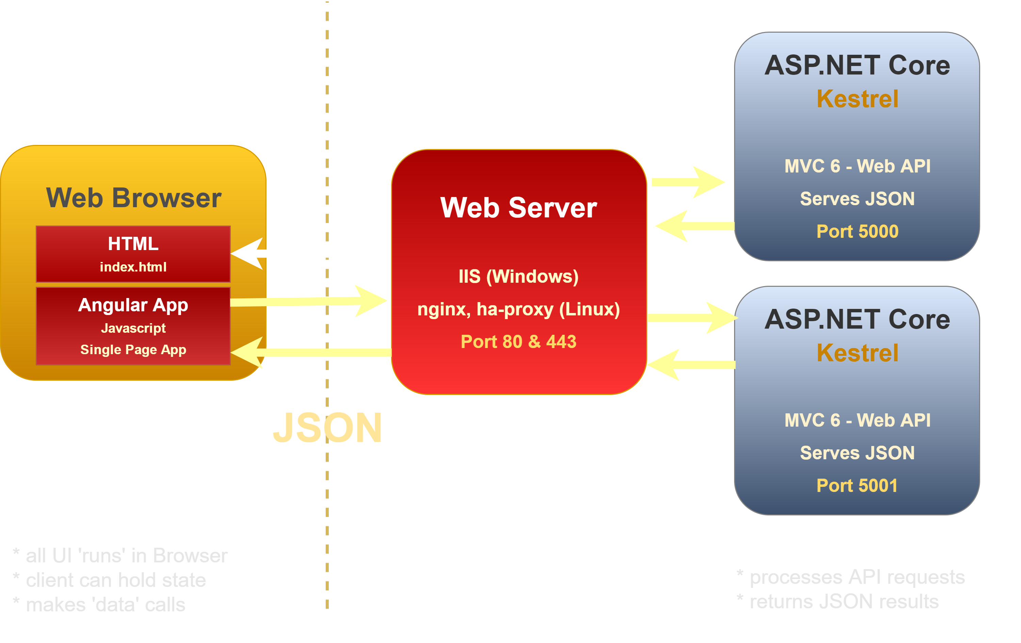




Angular and ASP.NET Core

Slide 5
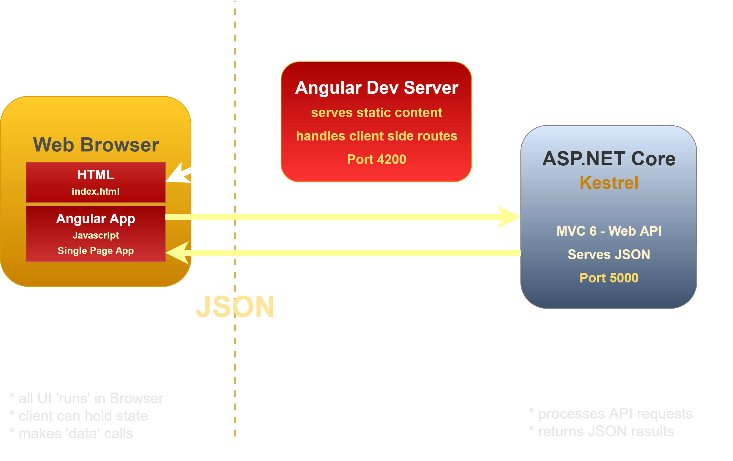
Angular and ASP.NET Core (dev)

Slide 6
Creating Angular Applications
Getting Started

Slide 7
What is Angular?
JavaScript Application Platform
Full featured framework for building SPA Applications
Not geared for use as a drop-in framework
Features
Simple Component Model w classes as components
HTML template binding
Client side MVVM
Module system (ES6/Typescript)
Fast, intuitive databinding
Reactive event system (rxJs)
Built-in HTTP support
Built-in Form Validation
Built-in Routing

Slide 8
Why Angular?
Declarative Programming
Write your code to a model not the DOM
Remove DOM spaghetti code
Drastically reduced code size
Data is live – change the value the UI changes!
Support features: Http, Validation, Routing etc.
Modular JavaScript
Module system makes imports 'safe'
Dependency Injection declares dependencies up front
Atomic code through components as building blocks
Full Featured
Unified paradigm for most application ops
Can be used as only library
Angular is a platform – everything in one place

Slide 9
Getting Started with Angular
Use the Angular CLI
Provides most dev/build features in one place
ng serve – run live reload web server
ng build – build production ready builds
ng generate – create new components/services
Don't get bogged down
Initially – JUST DO IT!
Create Components
Add Routes
Ignore the pile of tech involved
Pick up the tech as you go and need it
Rock on!
After initial tech overload Angular is very productive

Slide 10
Angular Build Process
Requires Build Pipeline
Requires JS build system and transpilation (Typescript->ES5 or ES6->ES5)
Angular CLI makes getting started much easier
Overwhelming amount of dependencies and tech
Just get started – don't get caught up in the details
Typescript or ES6
Not just a script file to add to a page
Very complex internal architecture, but easy to use
Angular CLI Simplifies
Wraps WebPack Build Processing
Provides 90% Scenario out of the box
Compresses and bundles scripts
Compresess and bundles CSS, LESS, SASS

Slide 11
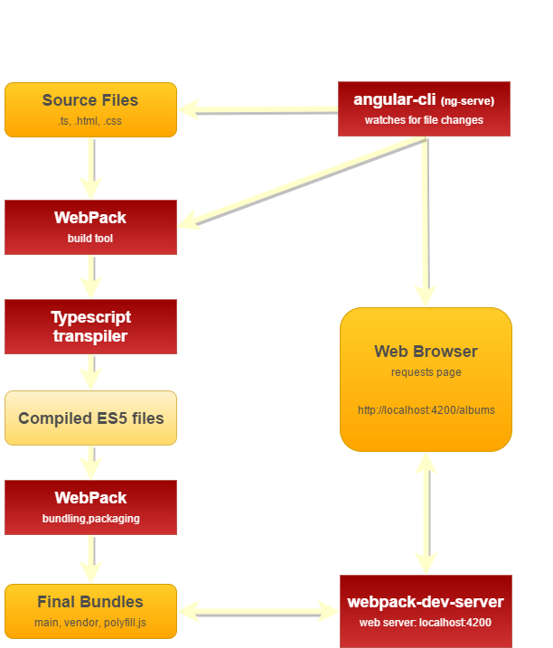
Angular/Typescript Build Process

Slide 12

Typescript
A better JavaScript
Superset of JavaScript – all JavaScript is valid!
ES5 and ES6 compatible syntax (part of mission statement)
Provides many additional features
Requires Transpilation (as does ES6)
Features
Real Classes (based on ES6)
Module System (based on ES6)
Optional strong typing (name:Address = new Address())
Meta Data Support (annotations used in Angular)
Tooling support: Typescript Service
Excellent Intellisense support in many editors

Slide 13
Start Simple
There’s a lot to learn
No need to understand it all, all at once
Start with what you need to get started
Pick up more advanced features later
Get Started
Use the Angular CLI for initial guidance
Create simple page based components
Figure out dataBinding & event handling
Understand ES6/Typescript basics
Learn as you go
Use the documentation – it’s excellent
Lots of good examples out there – code by numbers
StackOverflow
Learn as you go and circle back to more advanced topics

Slide 14
Key Features
Classes as Components
Classes are the 'model'
All dependencies are declared up front
Constructor Dependency Injection
Module Loading
Breaks up JavaScript code by class
Allows for script file dependencies to be found
DataBinding
Class properties bind to the View
<div>{{property}}</div> - literal one-way binding
[value]="property" – attribute one-way binding
[(ngModel)]="property" – two-way control binding (banana in a box)
Event Handling
(click)="method" – event binding
Event Emitter – publish events

Slide 15
What's a Component?
Typescript Class
Properties are the 'model' data
Methods are the event handlers
MetaData
Describes component characteristics and dependencies
Templates
HTML Template holds the 'View' for the component
Templates can be strings (.Template)
Templates can be files (.TemplateUrl)
Compiled into JavaScript
Compiled into the output bundle (main.browser.js)

Slide 16
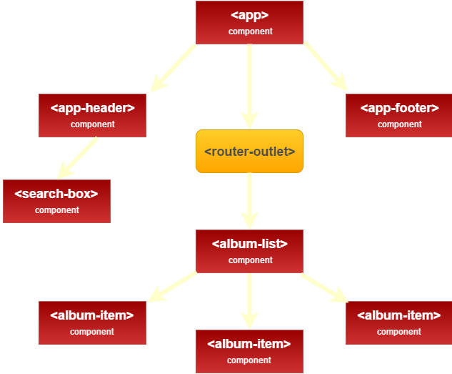
Angular Classes as Components

Slide 17
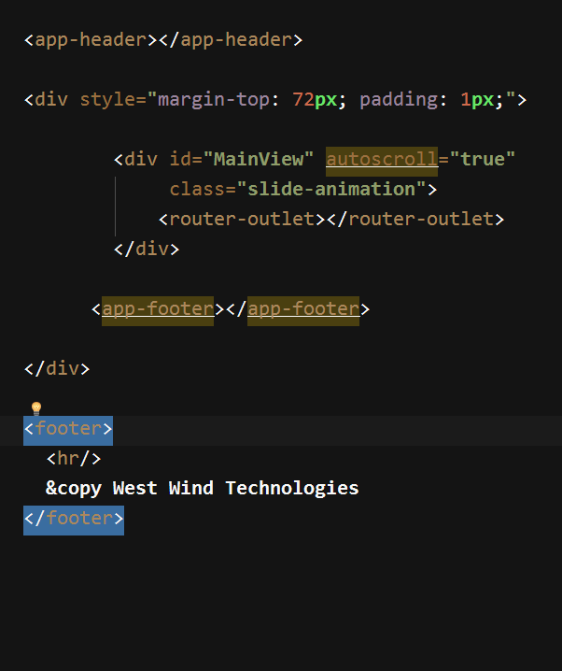
Top Level Composition
Component
View Outlets (router) renders a router view
Component

Slide 18
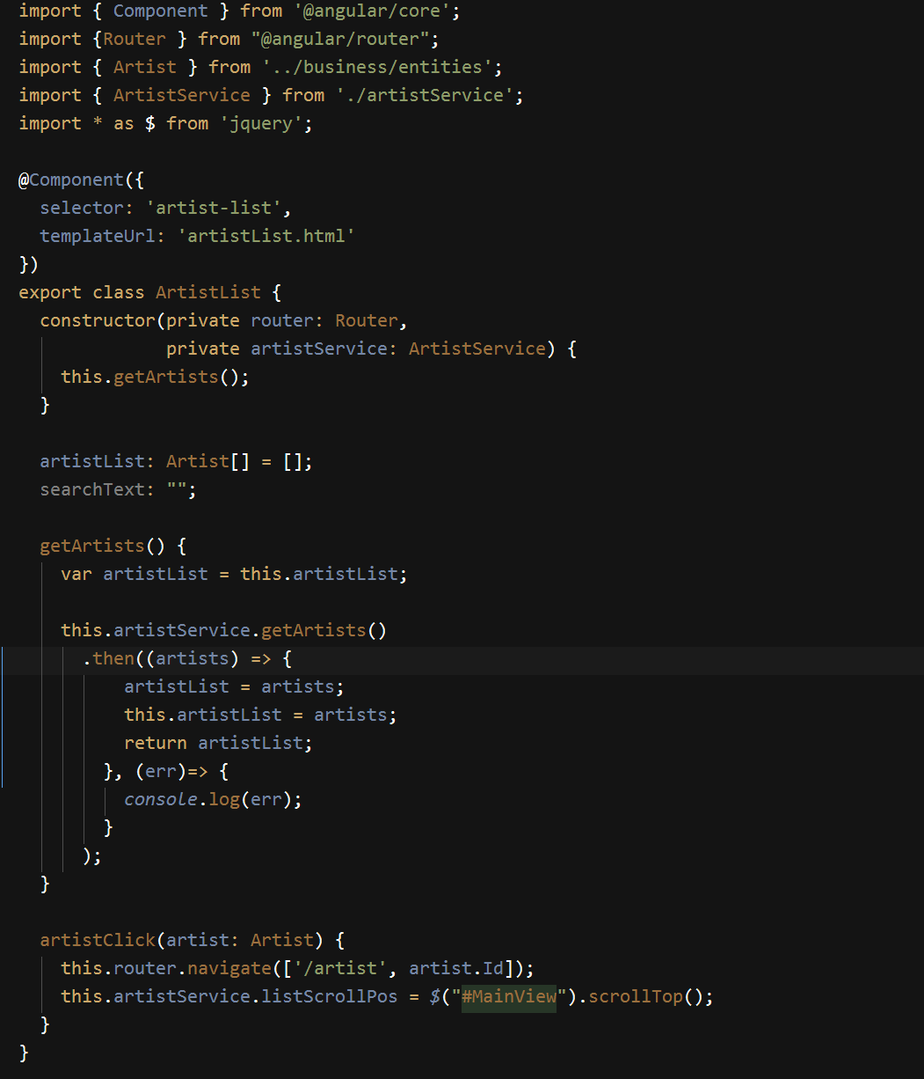
Typescript Classes as Components
Import dependencies
Component meta data
Class definition
dependencies are injected in ctor
Properties for model binding
Methods for event binding and logic

Slide 19
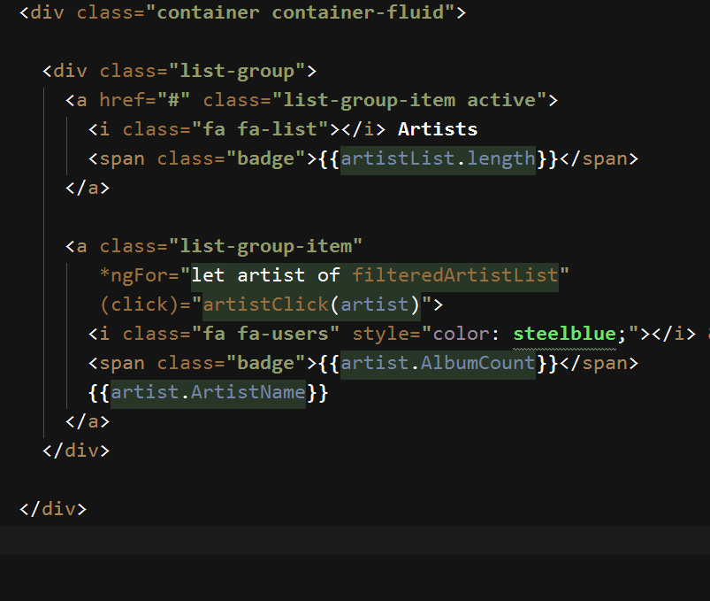
Html View
{{ Literal Bindings}}
*ngFor – looping component
(event) binding

Slide 20
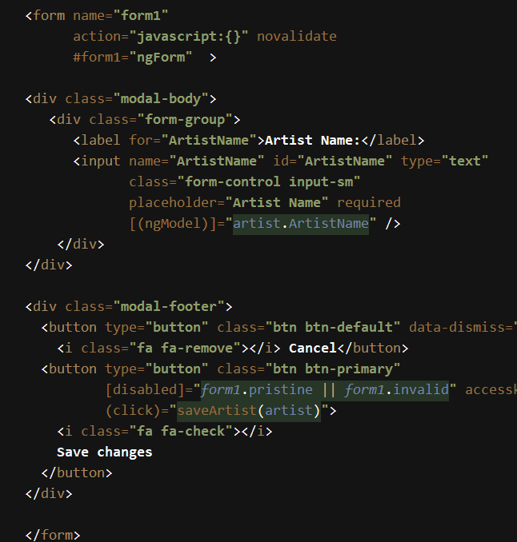
Databinding and Forms
Databinding
HTML Markup with enhancements
Template tags: {{ expression }}
One way binding: [attribute]="expression"
Two way binding: [(ngModel)]="expression"
Event binding: (click)="method()"
Databinding: any attribute and any event!
Directives
*ngIf – conditional rendering of element
*ngFor – loop construct
[ngClass] = "{selected: activeTab == 'options'}"
Form Validation
CSS Classes for state:
ng-valid,ng-invalid, ng-touched,ng-pristine
#form1="ngForm"
form1.invalid expression

Slide 21
Angular MV*
Html Page (index.html)
Template (View)
html/css
Html template
Displays rendered content
Component
Javascript
properties hold Model data
methods handle event logic
drives View logic
uses services to load Model
Service Javascript fetches data
can persist data
business/logic rules

Slide 22
Angular Coponent Classes
Components are the Traffic Cop
‘CodeBehind’ for Views
Responsibility: Update the model for the View
Sit between Model and the View
Sets up Model data for binding
Coordinates between Services & Model to retrieve data
Feeds its model to the View
Keep it simple!
Break out your components
Many components per feature page
Offload ‘business logic’ and data request to Services
Try to always use the Model to update display behavior
Revert to DOM only if you have to

Slide 23
ASP.NET Core for Apis
.NET goes cross platform

Slide 24
ASP.NET Core on the Server
Complete re-write of ASP.NET
High performance
Cross platform
Platform Independent
Windows, Linux, Mac
Works great on Docker
.NET Core Versioning
.NET Core 2.0 brings back sensible 'Runtimes'
Side by side support
Support for providing full runtime with application
High Performance
Kestrel Web Server (TechEmpower)
Lower memory usage than classic ASP.NET
More scalable for Cloud operation

Slide 25
ASP.NET & .NET Core
ASP.NET
Web API
MVC
Razor Pages
Middleware
ASP.NET Kestrel Web Server
Full .NET CLR
.NET Core CLR
Host
Self-hosted
OS

Slide 26
ASP.NET Core Basic Concepts
Console Apps
Every .NET Core app is a Console app
Every ASP.NET app is a .NET Core (2.0) app
Hosting is self contained in Kestrel
Command Line Tooling
Build and Run is done through Command Line Tooling
dotnet new dotnet restore dotnet build dotnet run
Visual Studio and other tools use CLI tools
.NET Core 2.0 brings back 'Runtimes'
.NET Core Runtime or SDK needs to be installed
Results in smaller build folders and deployments
Runtimes can be referenced through build tooling
Full self-contained installs still work as well

Slide 27
The more things change…
… the more they stay the Same
Most ASP.NET MVC/API concepts remain
Most changes are in 'plumbing' and setup
Moving to .NET Core should be familiar for .NET devs
But not the Same
Configuration of ASP.NET is completely different
Everything is loaded through Dependency Injection
Lots of configuration details
But: Changes for the Better
New multi-target SDK Project Format
Modular pipeline – use only what you need
Dependency Injection for components
Proper middleware pipeline
Easier extensibility story

Slide 28
API Projects
API and MVC are now one Framework
Controllers can serve data (Api) or ActionResult (MVC)
Single base class, single set of filters
Simpler implementation than ASP.NET WebAPI
APIs – keep it simple
Objects in Objects out
Throw exceptions for errors
Use an error Filter to format errors
Error Handling
Throw Custom Exceptions for application/logic errors
Create a custom ExceptionFilter (custom ApiException)
Override OnException to always return JSON
Use a consistent error result for serialization (custom ApiError)

Slide 29
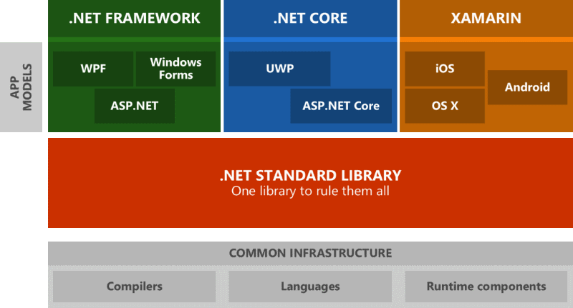
.NET Standard
A Specification Not an Implementation
Minimum required feature set across frameworks
Frameworks have to implement these features
Guaratees consistent .NET base features
If you create libraries – target .NET Standard

Slide 30
Angular and ASP.NET Together
doing the dance

Slide 31
Angular and ASP.NET
Not a Natural Fit
Angular wants to take over the entire client side
ASP.NET Provides its own Web publishing
Dev vs. Production
Running with the Development server
Production running behind a full Web Server / Proxy
Output Options
Separate sites
Single Site

Slide 32
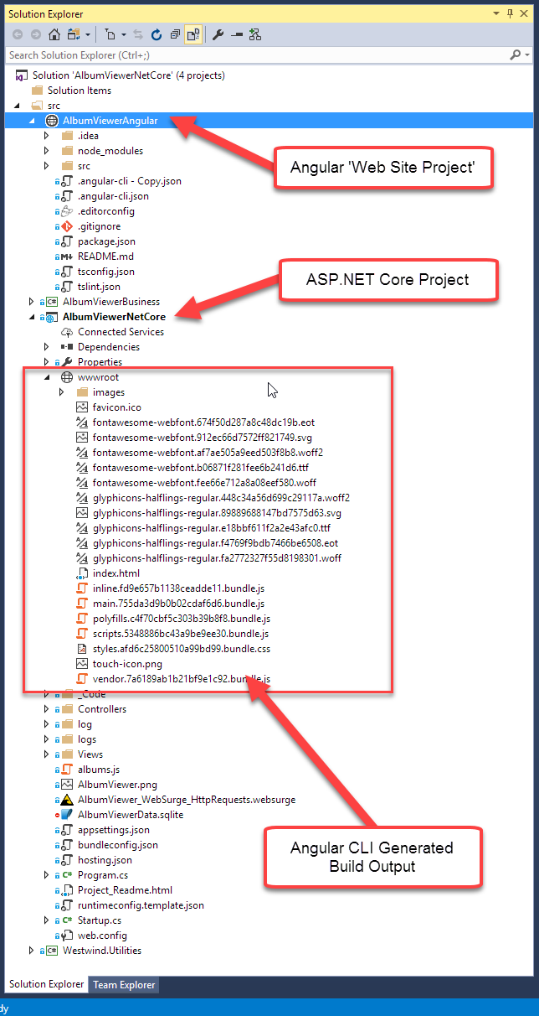
Angular & ASP.NET Core
ASP.NET API Project
Serve JSON data to Angular Front end
Data Access and Business Logic
Use Separate Projects
Core Project for API
Web Site Project for UI
Mark node_modules hidden
Build Angular output to ASP wwwroot
Typical Dev Usage
Angular runs ng-serve dev server
ASP.NET runs Kestrel
Or runs IIS Express
Production Usage
Use single site w/ merged wwwroot
Use separate sites/sub-domains

Slide 33
Angular and ASP.NET Core (dev)

Slide 34
Angular and ASP.NET Core

Slide 35
Deployment Approaches
Single Site Output
ASP.NET Core site hosts Angular Application
Need to build Angular CLI output into wwwroot
Pro: Easier to deploy and manage
Pro: Single Site hosting
Con: Angular CLI controls wwwroot (removes during dev, recreates on build)
Separate Sites
Use separate sites for Angular and ASP.NET API
main.site.com and api.site.com
Make sure to enable CORS in ASP.NET
Pro: Same as development process
Pro: Optimized servers for static and API
Con: requires multiple sites

Slide 36
Separation of Concerns
Server Side in .NET
Separate Web API functionality from 'business' rules
Move business logic/repositories into separate project
Break out additional utilities, support libs etc. into projects
Keep it modular
Client Side in Angular
Break out logic into Feature Folders
Break out larger silos into Modules
Reusable/Redistributable components work best with modules.

Slide 37
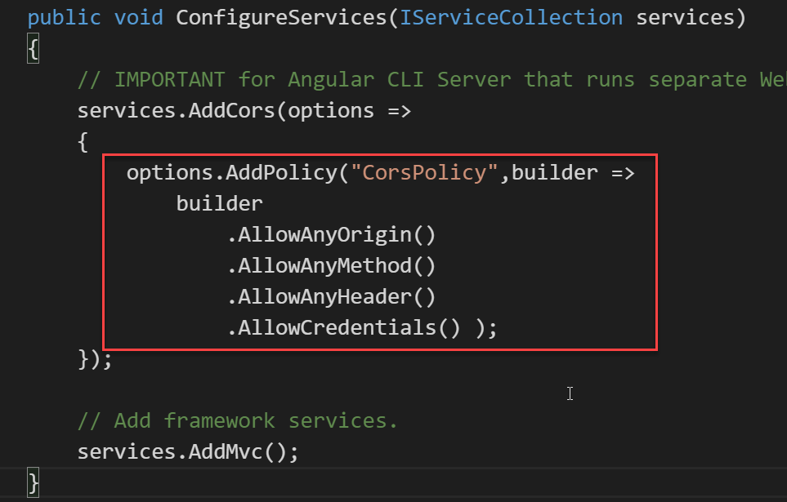
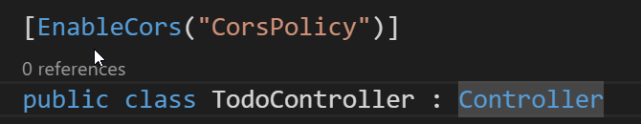
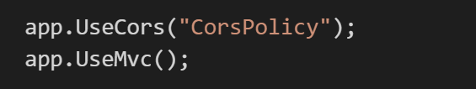
Angular and ASP.NET Core
Configure CORS in ASP.NET Core (Cross Origin Resource Sharing)
Build Output to wwwroot
Send Angular CLI build output to wwwroot
Allows ASP.NET Core App to run full App in Production
or

Slide 38
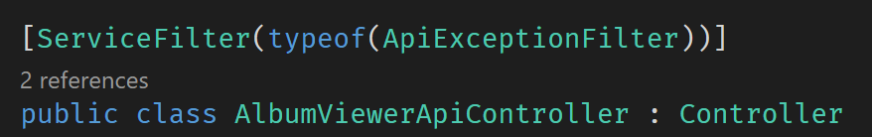
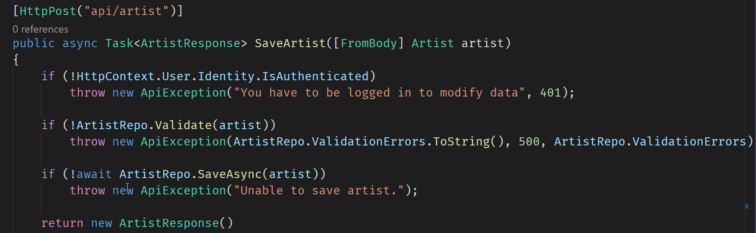
Application Error Handling (server)
Class Declaration
Handle Errors – Throw known Exception

Slide 39
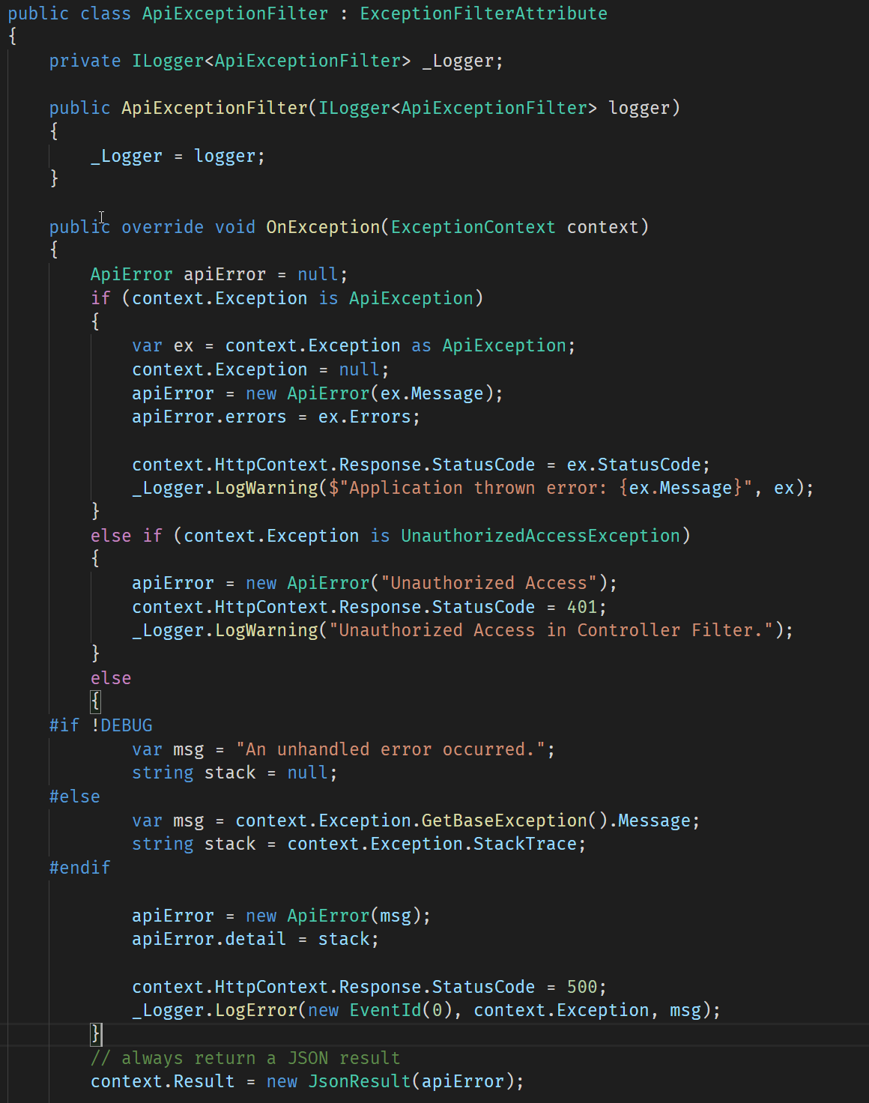
Application Error Handling (server cont.)

Slide 40
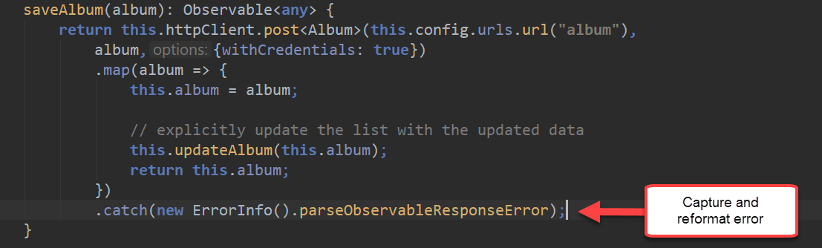
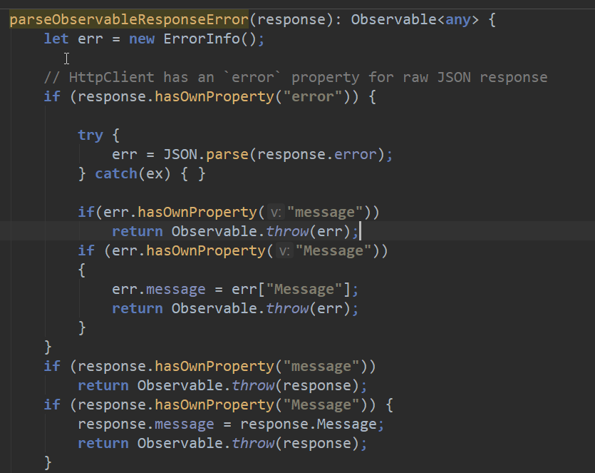
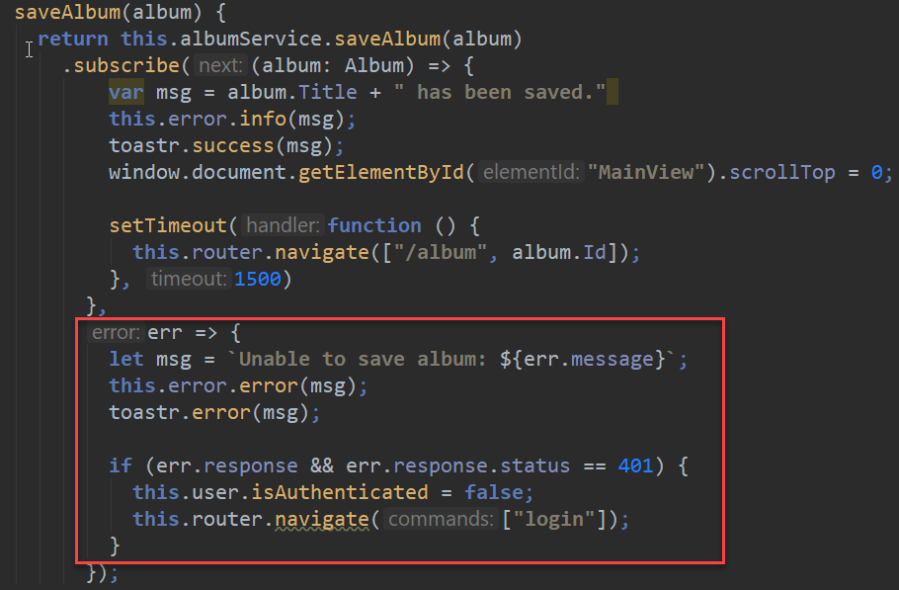
Http Error Handling (client)
Capture and reformat Http Errors
Always return a known Error Object

Slide 41
Server Side Authentication
Complex Identity System
Authentication/Authorization based on ASP.NET Identity
Uses EF to store and manage user accounts
Complex and woefully incomplete
Real world: Use Identity Server for full featured Auth
Identity server provides a full Auth solution
Token Service, user management, login as a service
Includes backend user administration
Simple Authentication is possible in Core
You can implement Simple Cookie/Claims Authentication
Only takes a few lines of code on Server

Slide 42
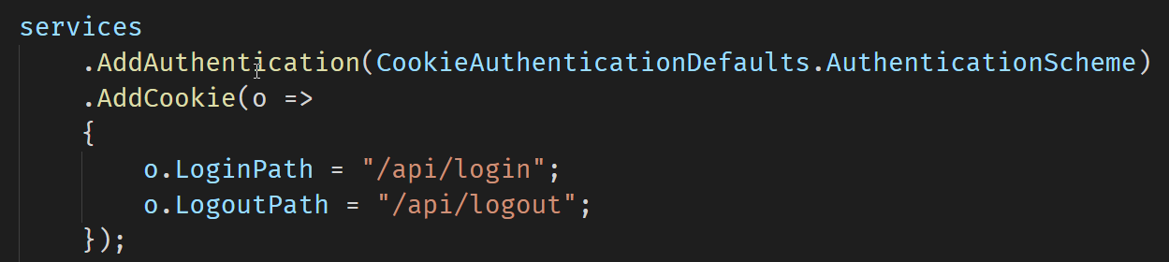
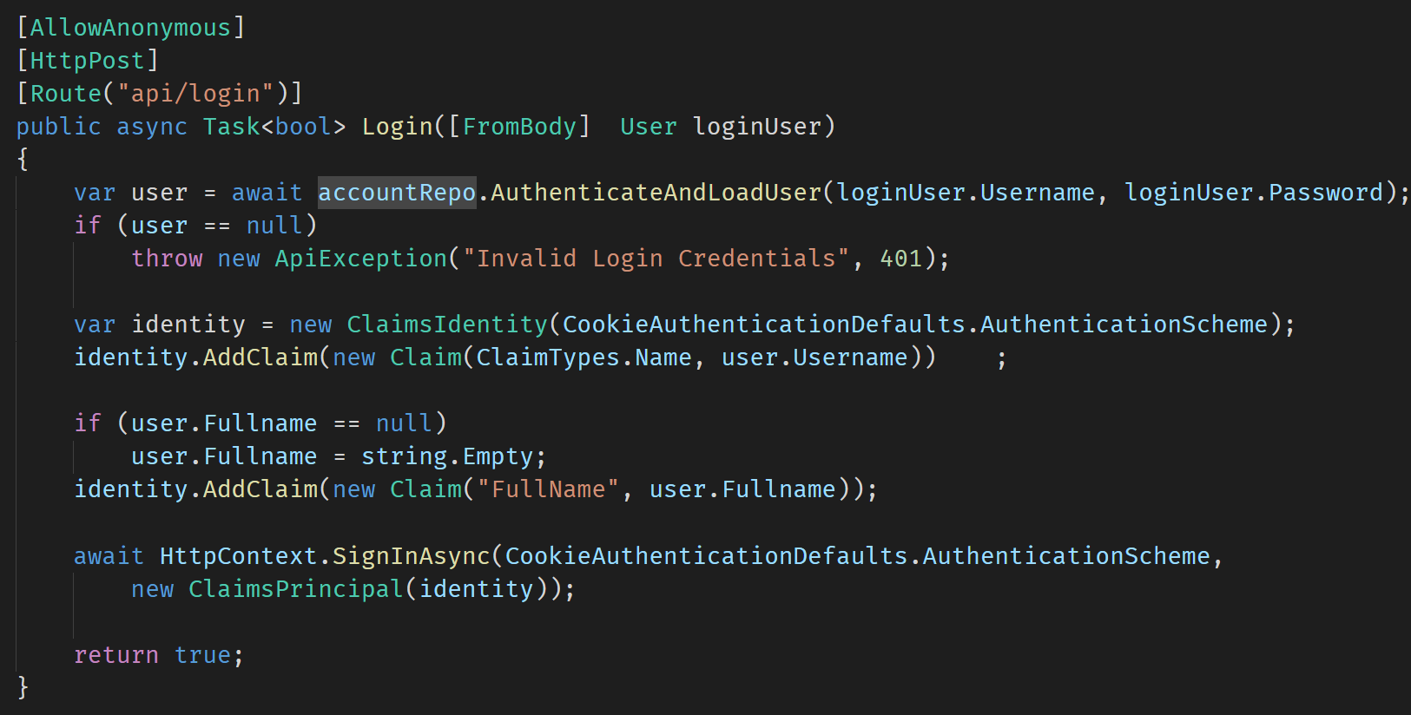
Simple Authentication (server)
Configure Authentication Scheme
Simple Claims based Cookie Signin

Slide 43
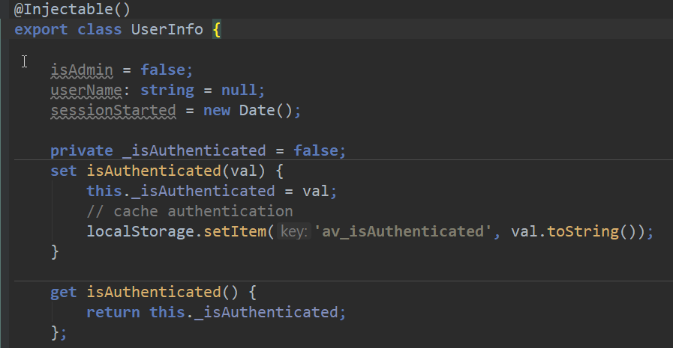
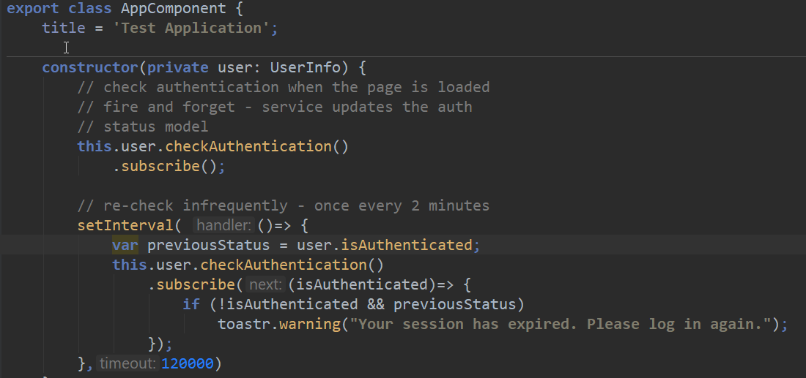
Client Side Authentication
Cache Login Status on Client
Call Login on the Server
On success store status in a service property
Check back for Status
Check at intervals
Verify if user is still logged in
Or: Intercept HTTP request and update
On changed login status show a message
Never trust Client Auth Status
Remember: It's JavaScript
Client can mess with your client code
Always double check authentication on the server!

Slide 44
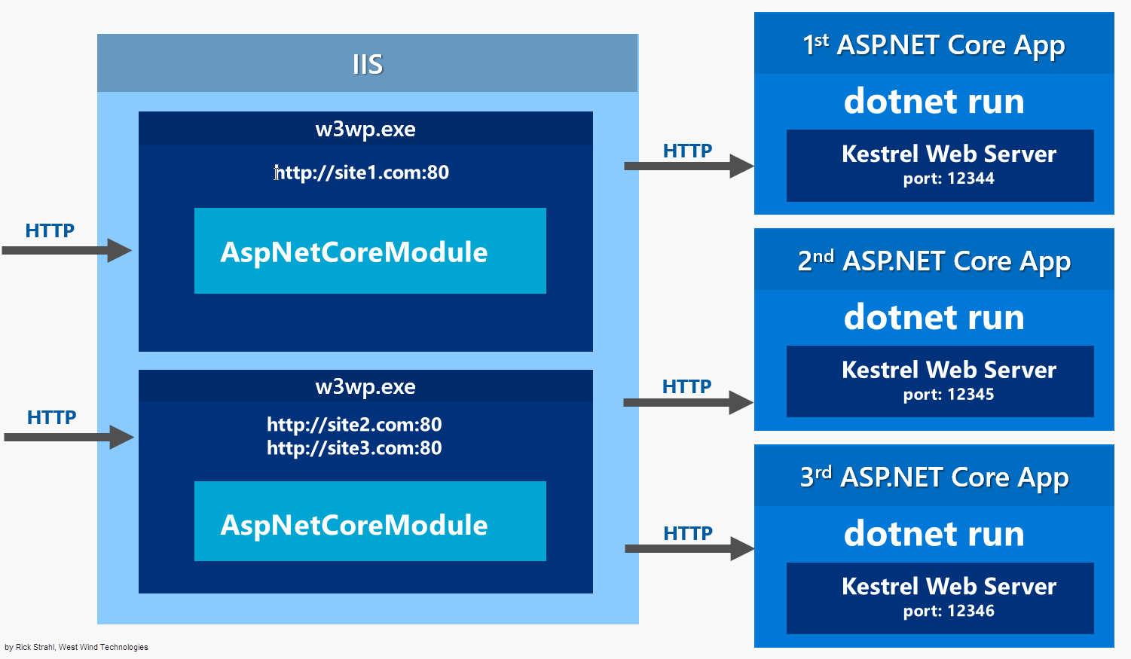
ASP.NET Core on IIS

Slide 45
Let IIS Serve Static Content
AspNetCoreModule
Forwards all requests from IIS to Kestrel
Includes all files – static, and application
Static Content
Kestrel is slow with static content
IIS Kernel Caching is very fast
IIS has built-in Content Compression
IIS – Use IISRewrite
Rewrite static file Url
Rewrite HTML 5 Client Routing
Everything else passed to Kestrel

Slide 46
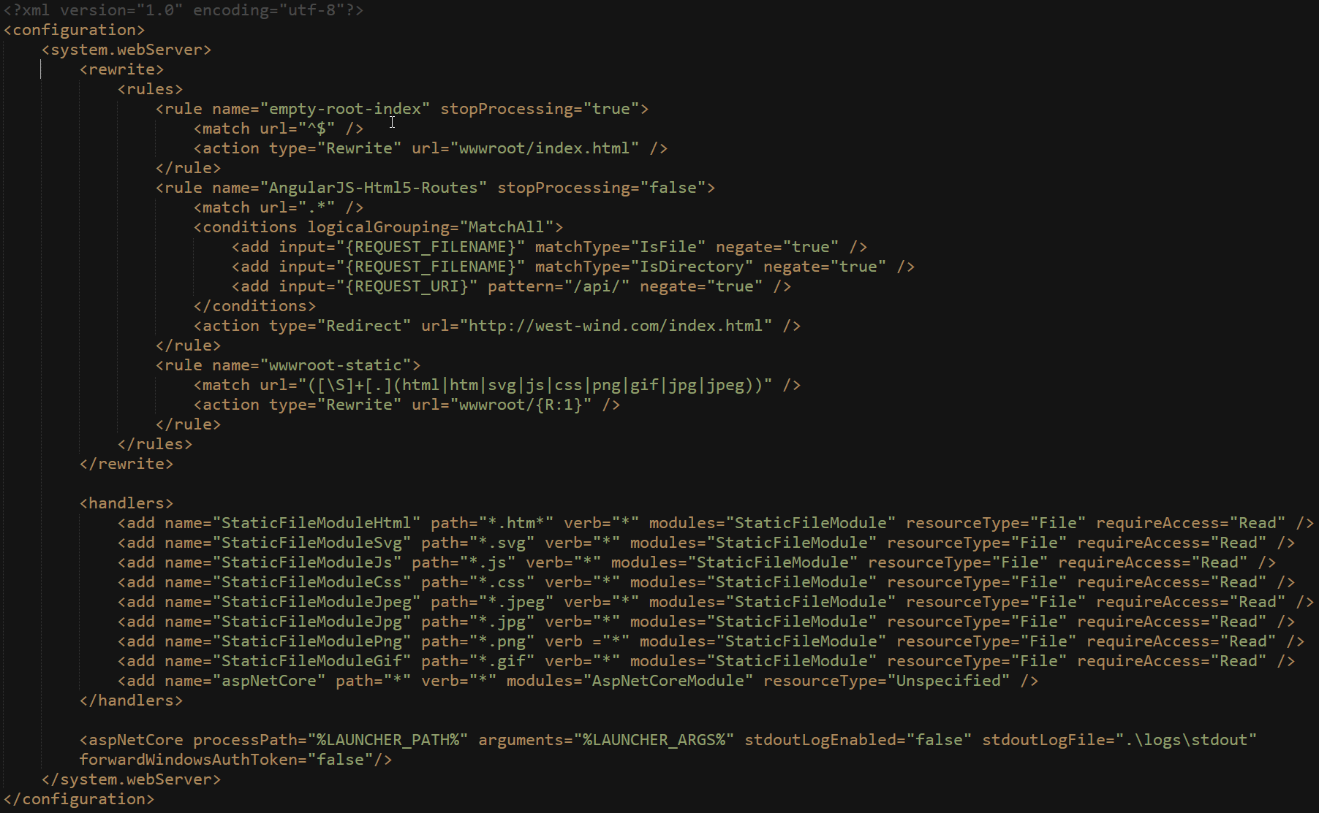
IIS Rewrite Rules for Static Files/HTML 5 Routes

Slide 47
Publishing ASP.NET Core on IIS
ASP.NET Core Apps are published
dotnet publish creates a publish folder
Publish folder is self contained
Your compiled binaries
Support libraries
Optionally can contain entire runtime
Usually references pre-installed runtime
VS Publish and MsDeploy
Existing tools work to deploy to a live Web site
Make sure server has .NET Core Runtimes installed (unless you build with local runtimes)
Make sure server has Windows Server Hosting pack (installs ASP.NET Core Module)

Slide 48
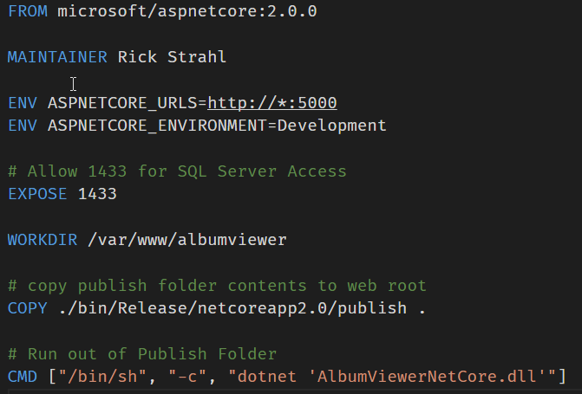
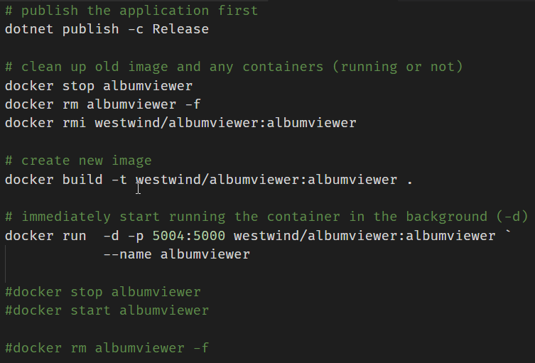
Creating a Docker Image
Build Image from Publish output

Slide 49
Angular 2.0 Summary
Powerful framework
End to end client side framework
Modular JavaScript using TypeScript
Two way databinding
DataBinding changes Everything!
Separation of code and DOM Manipulation
Model updates bind DOM values
Changes are real-time
Learning Curve
Initial learning curve is omnious
Actually building apps is easy through
Once you learn the 5 or so common concepts you can apply them for 90% of what you need to know
Google is your friend!

Slide 50

Thank you
Github Repo for Samples, Slides, Session Notes
https://github.com/RickStrahl/DI2017-AspNet-Core-Angular
Album Viewer Sample Application
https://github.com/RickStrahl/AlbumViewerVNext
Contact Rick:
weblog.west-wind.com
rstrahl@west-wind.com
west-wind.com/contact
@RickStrahl

